Slide 1
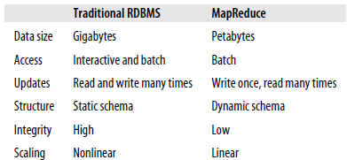
Why Hadoop?
Big Data!!
Storage
Analysis
Data management

Slide 2
Why Hadoop?
Big Data!!
Storage
Analysis
Data management

Slide 3
Advantages of Hadoop
Vast amounts of data
Economic
Efficient
Scalable
Reliable

Slide 4
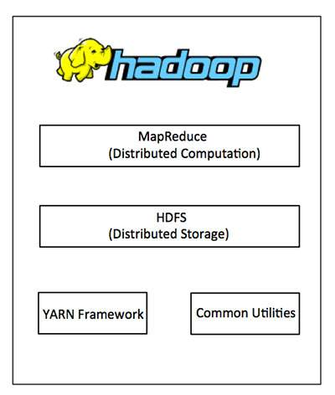
The Core Apache Hadoop Project
Hadoop Common:
Java libraries and utilities required by other Hadoop modules.
Hadoop YARN:
a framework for job scheduling and cluster resource management.
HDFS:
A distributed file system
Hadoop MapReduce:
YARN-based system for parallel processing of large data sets.

Slide 5
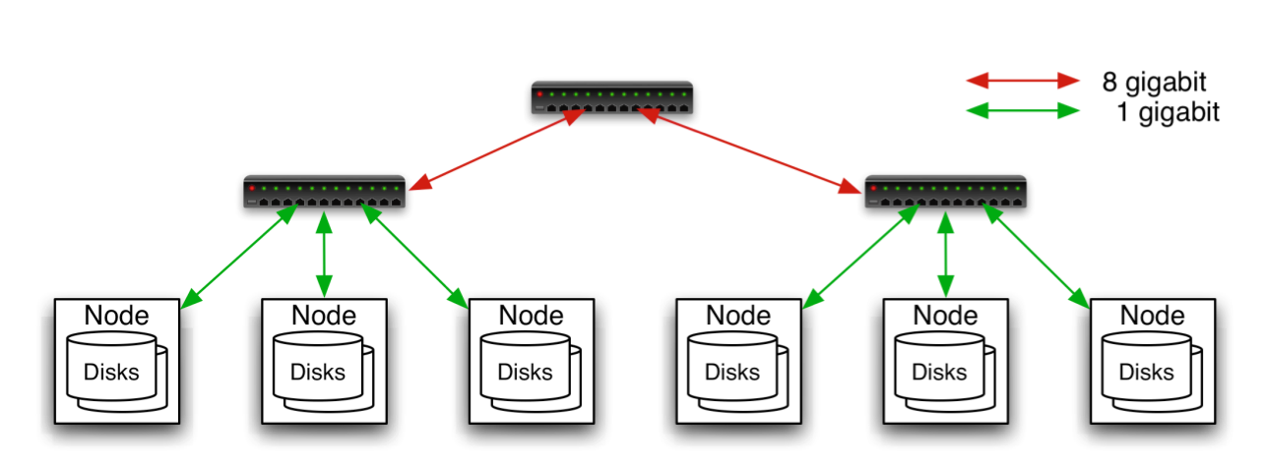
Hadoop Cluster
Typically in 2 level architecture
Nodes are commodity PCs
30-40 nodes/rack
Uplink from rack is 3-4 gigabit
Rack-internal is 1 gigabit
Aggregation switch
Rack switch

Slide 6
Hadoop Related Subprojects
Pig
High-level language for data analysis
HBase
Table storage for semi-structured data
Zookeeper
Coordinating distributed applications
Hive
SQL-like Query language and Metastore
Mahout
Machine learning

Slide 7
MapReduce Workflows
When data processing gets more complex, this complexity is generally manifested by having more MapReduce jobs, rather than having more complex map and reduce functions.
For more complex problems, it is worth considering a higher-level language than Map-Reduce, such as Pig, Hive, Cascading, Cascalog, or Crunch.
In other words, as a rule of thumb, think about adding more jobs, rather than adding complexity to jobs.

Slide 8
Unit Test
The map and reduce functions in MapReduce are easy to test in isolation.
For known inputs, they produce known outputs.
since outputs are written to a “Context” (or an OutputCollector in the old API), rather than simply being returned from the method call, the Context needs to be replaced with a mock so that its outputs can be verified.

Slide 9
Unit test for MaxTemperatureMapper

Slide 10
Cont…
The test is very simple: it passes a weather record as input to the mapper, then checks the output is the year and temperature reading.
The input key is ignored by the mapper, so we can pass in anything, including null as we do here.
To create a mock Context, we call Mockito’s mock() method (a static import), passing the class of the type we want to mock.
Then we invoke the mapper’s map() method, which executes the code being tested.

Slide 11
Finally, we verify that the mock object was called with the correct method and arguments, using Mockito’s verify() method.
Here we verify that Context’s write() method was called with a Text object representing the year (1950) and an IntWritable representing the temperature (−1.1°C).
Refer 156-161 pages

Slide 12
Unit tests with MRUnit
the MRUnit project (http://incubator.apache.org/mrunit/), which aims to make unit testing MapReduce programs easier.

Slide 13
Anatomy of a MapReduce Job Run
One can run a MapReduce job with a single method call: submit() on a Job object.
In releases of Hadoop up to and including the 0.20 release series, “mapred.job.tracker” determines the means of execution.
If this configuration property is set to local, the default, then the local job runner is used. This runner runs the whole job in a single JVM.
It’s designed for testing and for running MapReduce programs on small datasets.
In Hadoop 0.23.0 a new MapReduce implementation was introduced.
The new implementation (called MapReduce 2) is built on a system called YARN

Slide 14
Classic MapReduce (MapReduce 1)
A job run in classic MapReduce is shown in the figure.
At the highest level, there are four independent entities:
The client, which submits the MapReduce job.
The jobtracker, which coordinates the job run. The jobtracker is a Java application whose main class is JobTracker.
The tasktrackers, which run the tasks that the job has been split into. Tasktrackers are Java applications whose main class is TaskTracker.
The distributed filesystem which is used for sharing job files between the other entities.

Slide 15
Job Submission
The submit() method on Job creates an internal JobSummitter instance and calls submitJobInternal() on it as shown in the above figure above.
Having submitted the job, waitForCompletion() polls the job’s progress once a second and reports the progress to the console if it has changed since the last report.
When the job is complete, if it was successful, the job counters are displayed.
Otherwise, the error that caused the job to fail is logged to the console.

Slide 16
Cont…
The job submission process implemented by JobSummitter does the following:
Asks the jobtracker for a new job ID by calling getNewJobId() on JobTracker.
Checks the output specification of the job.
Computes the input splits for the job. If the splits cannot be computed, because the input paths don’t exist, for example, then the job is not submitted and an error is thrown to the MapReduce program.
Copies the resources needed to run the job, including the job JAR file, the configuration file, and the computed input splits, to the jobtracker’s filesystem in a directory named after the job ID.

Slide 17
The other steps are:
Job Initialization
Task Assignment
Task Execution
Streaming and Pipes
Progress and Status Updates

Slide 18
Introduction to Hadoop Yarn

Slide 19
Yarn
YARN is the prerequisite for Enterprise Hadoop
providing resource management and a central platform to deliver consistent operations, security, and data governance tools across Hadoop clusters.

Slide 20
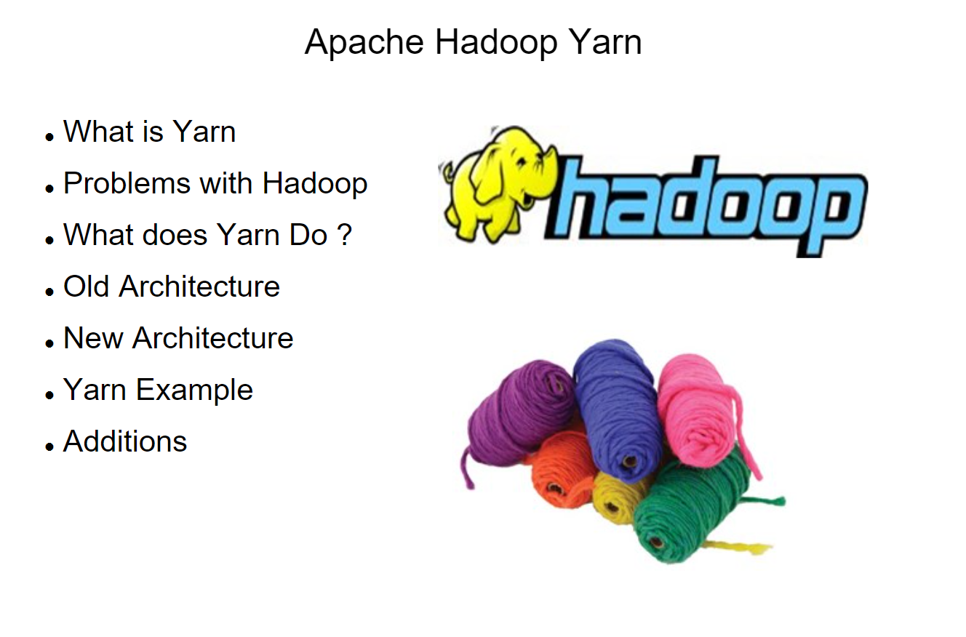

Slide 21
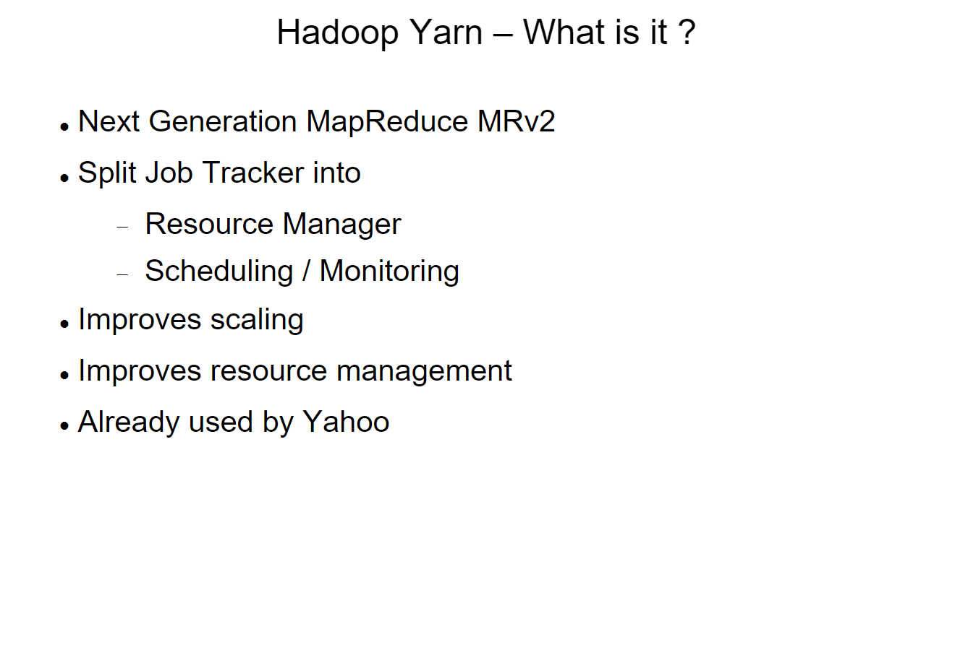

Slide 22
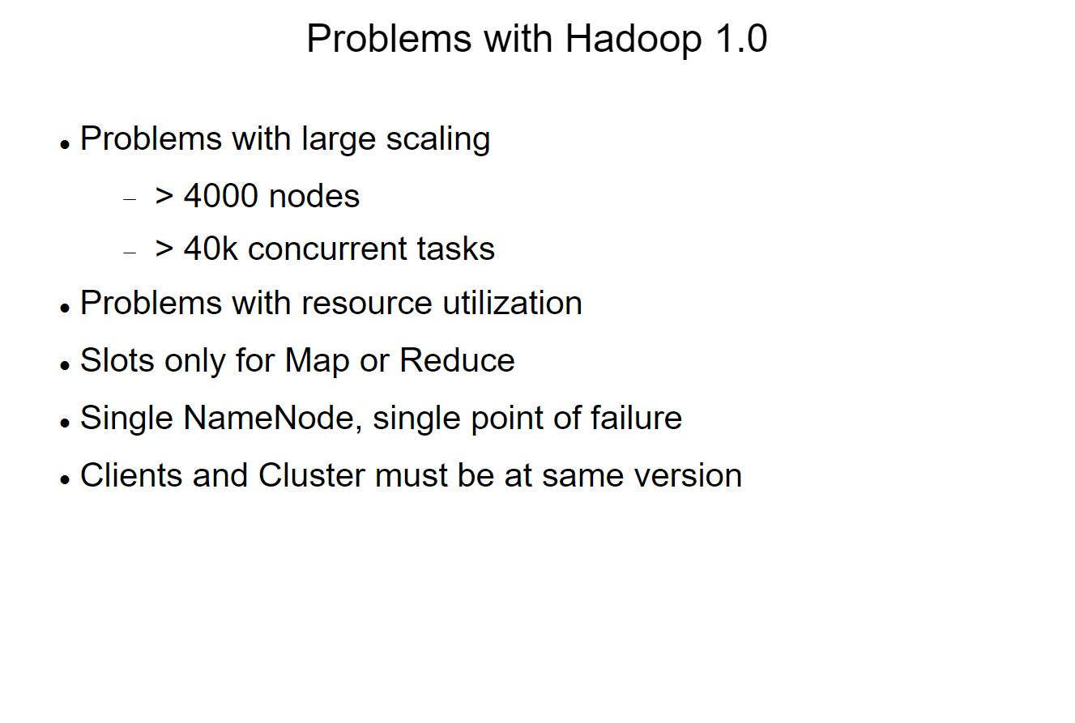

Slide 23
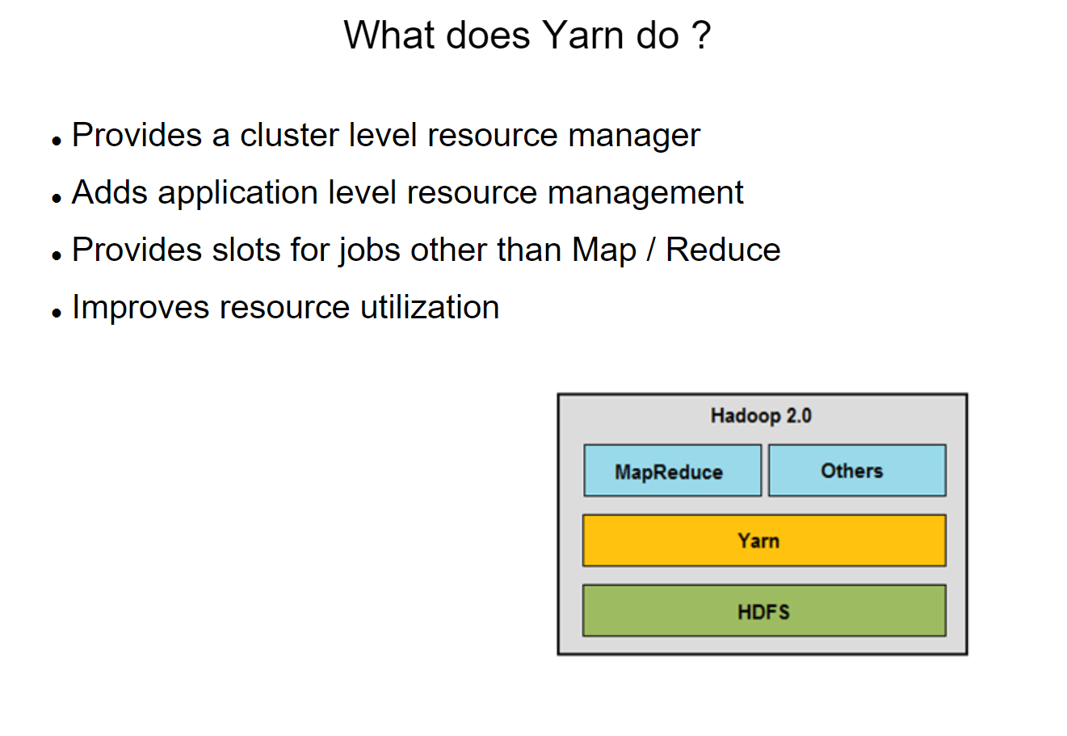

Slide 24
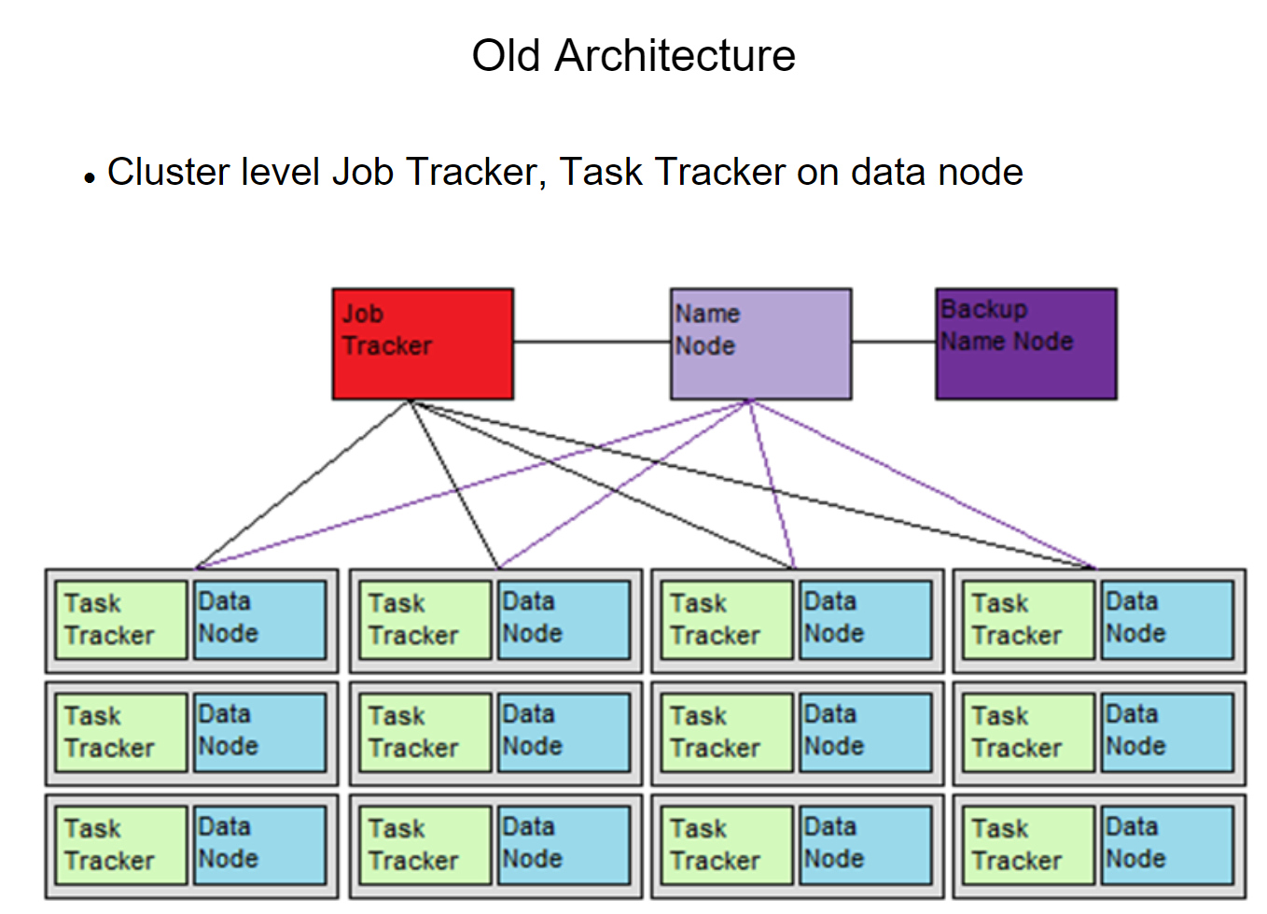

Slide 25
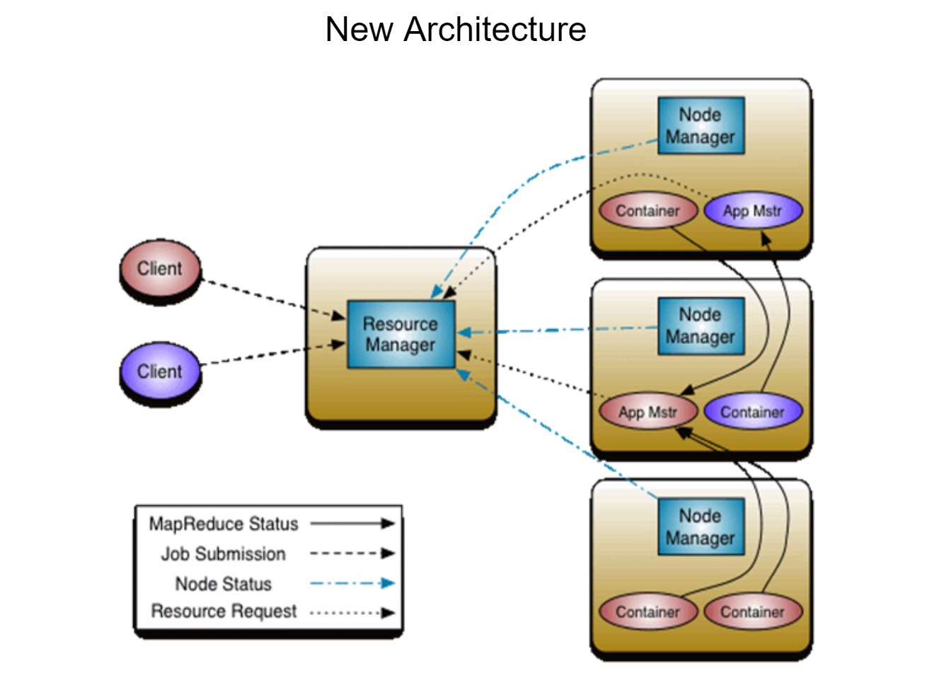

Slide 26
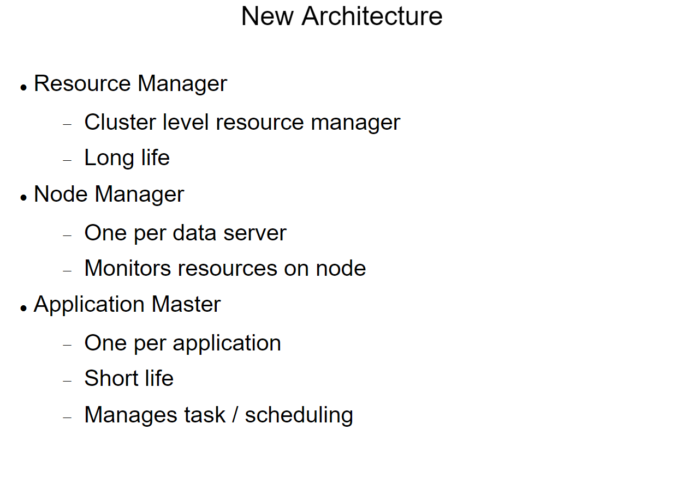

Slide 27
Apache YARN
Apache YARN (Yet Another Resource Negotiator) is Hadoop’s cluster resource management system.
YARN was introduced in Hadoop 2 to improve the MapReduce implementation
The Below diagram shows some distributed computing frameworks (MapReduce, Spark, and so on) running as YARN applications on the cluster compute layer (YARN) and the cluster storage layer (HDFS and HBase).

Slide 28
Anatomy of a YARN Application Run
YARN provides its core services via two types of long-running daemon:
a resource manager (one per cluster)
node managers
A resource manager (one per cluster) to manage the use of resources across the cluster.
Node managers running on all the nodes in the cluster to launch and monitor containers.
A container executes an application-specific process with a constrained set of resources (memory, CPU, and so on).
Depending on how YARN is a container may be a Unix process or a Linux cgroup

Slide 29
How YARN runs an application

Slide 30
How YARN runs an application
To run an application on YARN, a client contacts the resource manager and asks it to run an application master process.
The resource manager then finds a node manager that can launch the application master in a container.
It could simply run a computation in the container it is running in and return the result to the client. Or it could request more containers from the resource managers.
and use them to run a distributed computation

